Slide 1
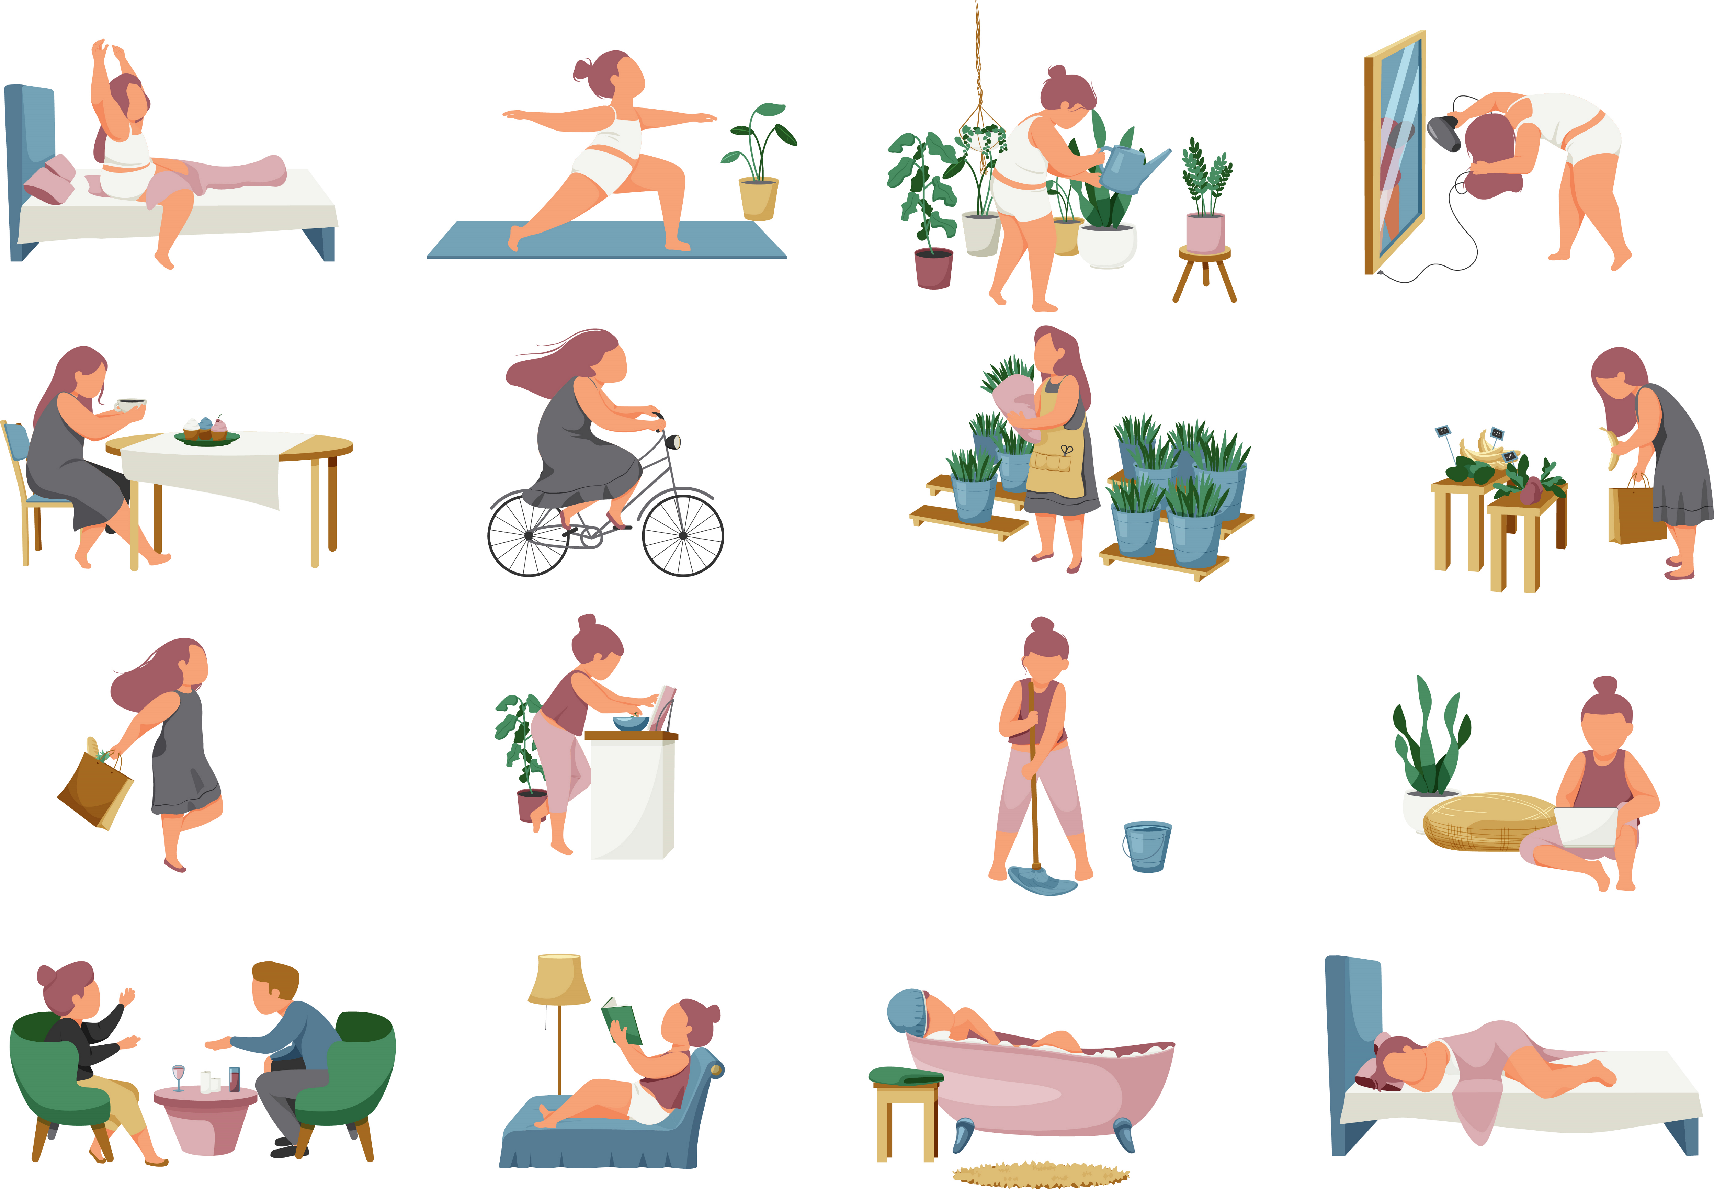

Slide 2
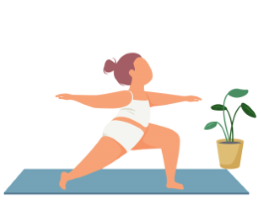
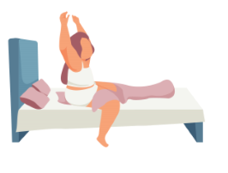
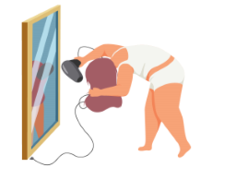
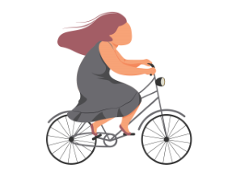
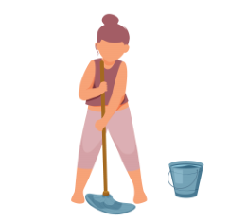
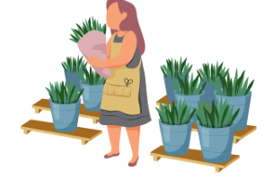
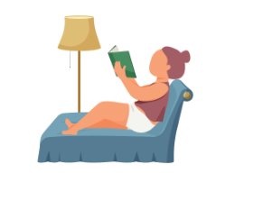
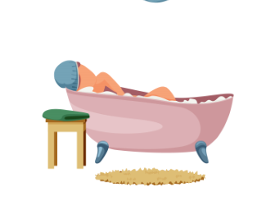
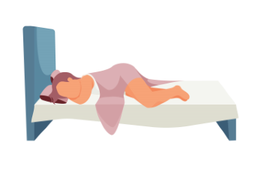
Catherine is..
..getting up
…is reading
…is taking her bath
…is sleeping

Slide 3
Present Continuous
..getting up
…getting up and stretching
…doing her yoga
Catherine is..
…drying her hair
… cycling
… mopping
…working
…is reading
…is taking her bath
…is sleeping
…reading
…taking a bath
…sleeping

Slide 4
Every day,
Catherine …
..getting up
…is reading
…is taking her bath
…is sleeping

Slide 5
Present Simple
..getting up
Every day,
Catherine …
…gets up and stretches
…does her yoga
…dries her hair
…cycles to work
..mops the floor
…works at a florist
…is reading
…is taking her bath
…is sleeping
…reads some of her novel
…takes a bath
…goes to bed

Slide 6
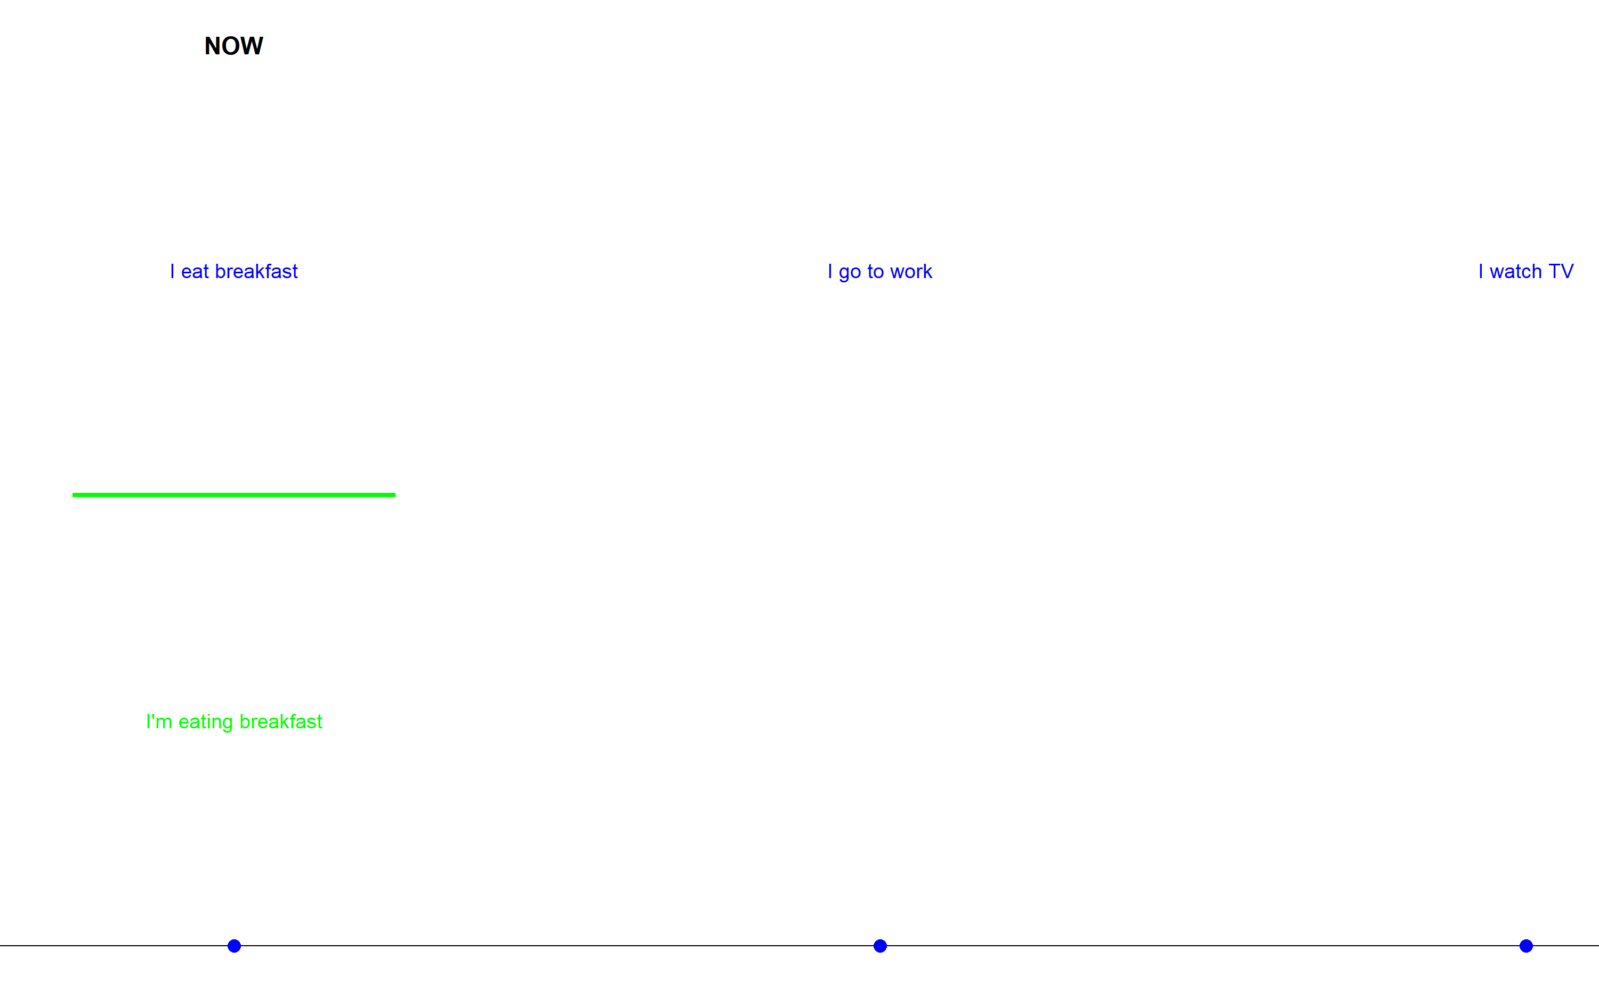
EVERY DAY EVERY DAY EVERY DAY EVERY DAY EVERY DAY EVERY DAY EVERY DAY EVER

Slide 7
She is watering her plants /ʃiː ɪz ˈwɔː.tə.rɪŋ hɜːr plɑːnts/
She is doing yoga /ʃiː ɪz ˈduː.ɪŋ ˈjəʊ.ɡə/
She is riding her bike /ʃiː ɪz ˈraɪ.dɪŋ hɜːr baɪk/
She is getting up /ʃiː ɪz ˈɡɛt.ɪŋ ʌp/
She is cleaning the floor /ʃiː ɪz ˈkliː.nɪŋ ðə flɔːr/

Slide 8
She eats breakfast /ʃiː iːts ˈbrek.fəst/
She reads every night /ʃiː riːdz ˈev.ri naɪt/
She waters the plants /ʃiː ˈwɔː.tərz ðə plɑːnts/
She does yoga /ʃiː dʌz ˈjəʊ.ɡə/
He rides his bike /hiː raɪdz hɪz baɪk/

Slide 9
Present Continuous
Present Simple
Subject + am/is/are+ verb-ing
Subject + base verb
I am + verb-ing
You/We/They are + verb-ing
He/She/It is + verb-ing
I am + verb
You/We/They + verb
He/She/It + verb +e (es)
-ing
/ɪŋ/
I am working
/am/ + /wɜːrkɪŋ/
She is reading
/ɪz/ + /riːdɪŋ/
They are playing
/ɑːr/ + /pleɪɪŋ/
I work
/wɜːrk/
She reads
/riːdz/
They play
/plez/

